Slide 1
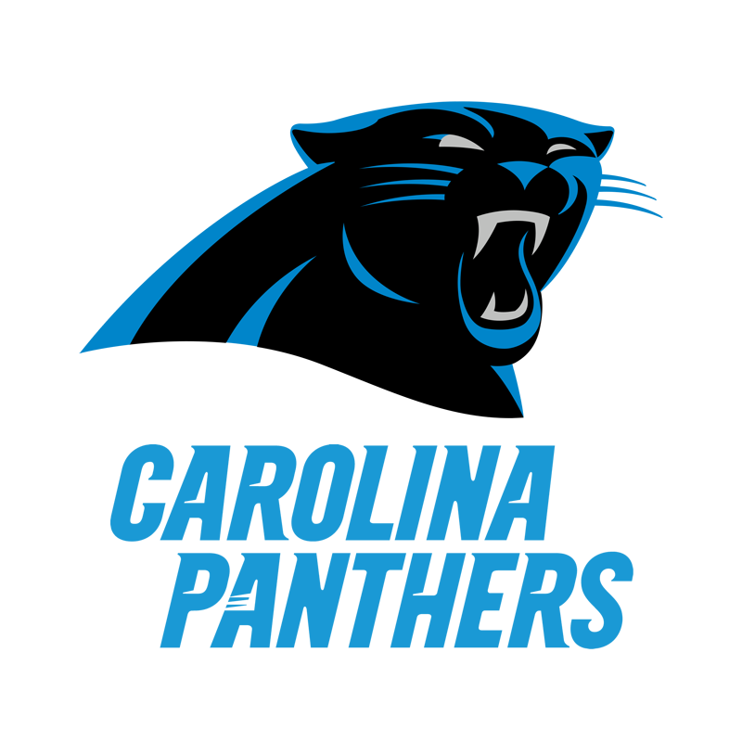
Carolina Panthers Analytics Presentation
Kyle Hayes
Tasmin Taylor
Jaren Robbins
Keerthi Talluri

Slide 2
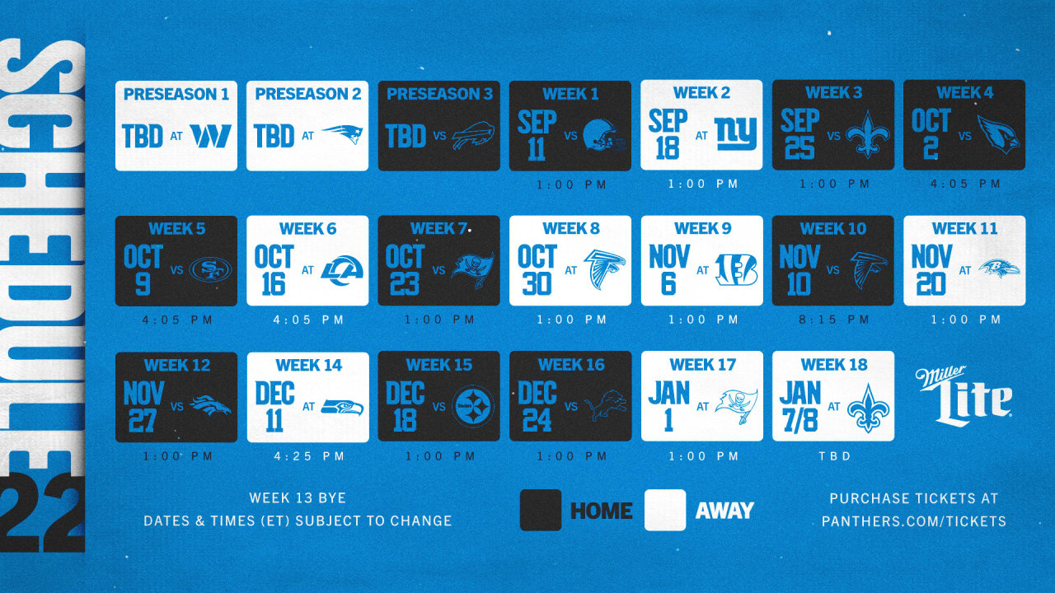

Slide 3
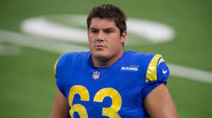
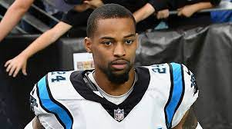
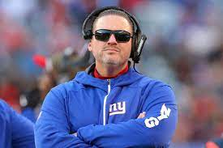
Panthers Information
Additions
Free Agency
S Xavier Woods
G Austin Corbett
RB D’Onta Foreman
WR Rashard Higgins
DI Matt Ioannidis
LB Damien Wilson
P Johnny Hekker
C Bradley Bozeman
ED Marquis Haynes
LB Cory Littleton
Coaching
OC Ben McAdoo
Departures
CB A.J. Bouye
DI Morgan Fox
DE Haason Reddick
DI DaQuan Jones
CB Stephon Gilmore
Carolina Panthers Lead Player Stats 2021

Slide 4
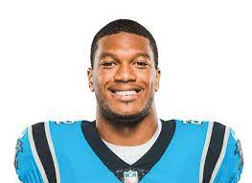
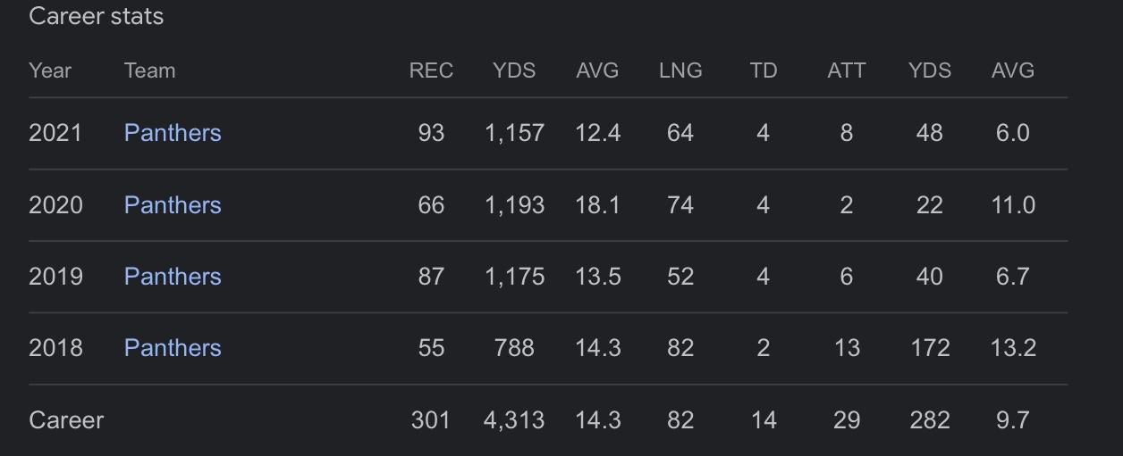
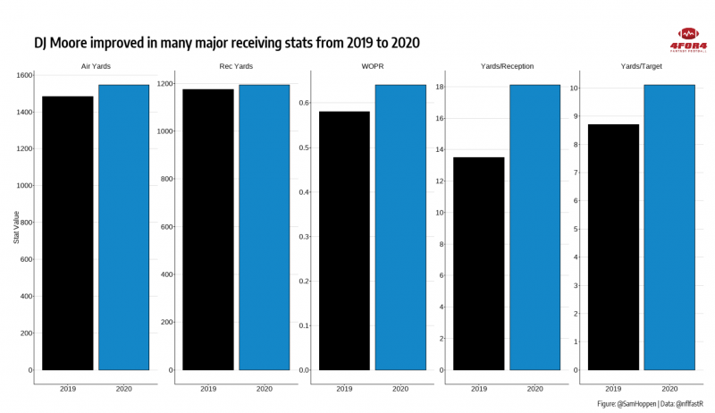
DJ Moore (Wide Receiver)
He averaged 14.1 ppg in 2020 and 14 ppg in 2021. He's been our number one wide receiver for the past three years and is consistently improving. Moore's target share actually rose in 2021. He saw a career-high 28.4% target share, good for 162 targets in 17 games.

Slide 5
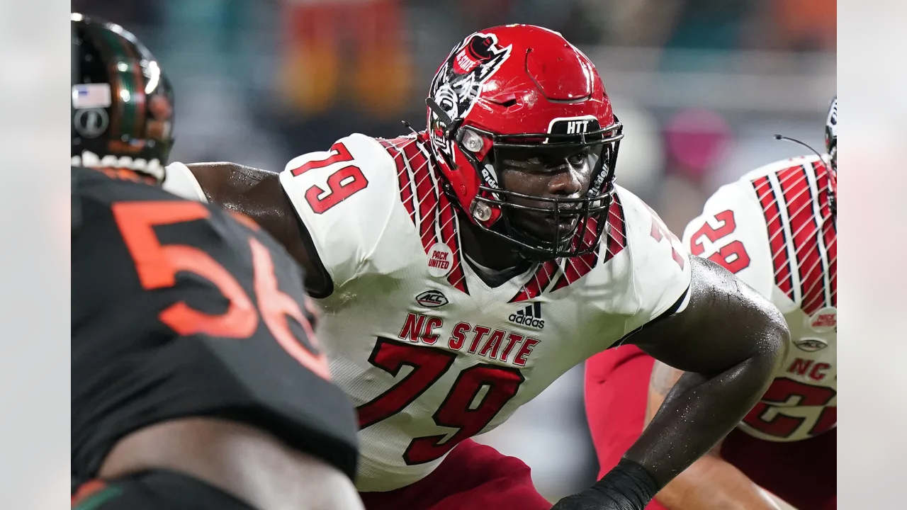
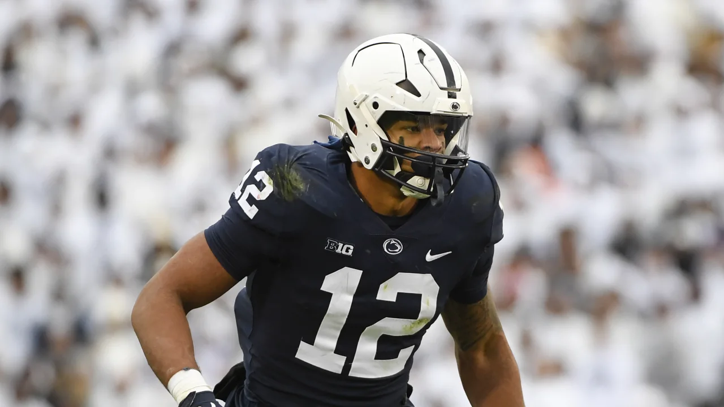
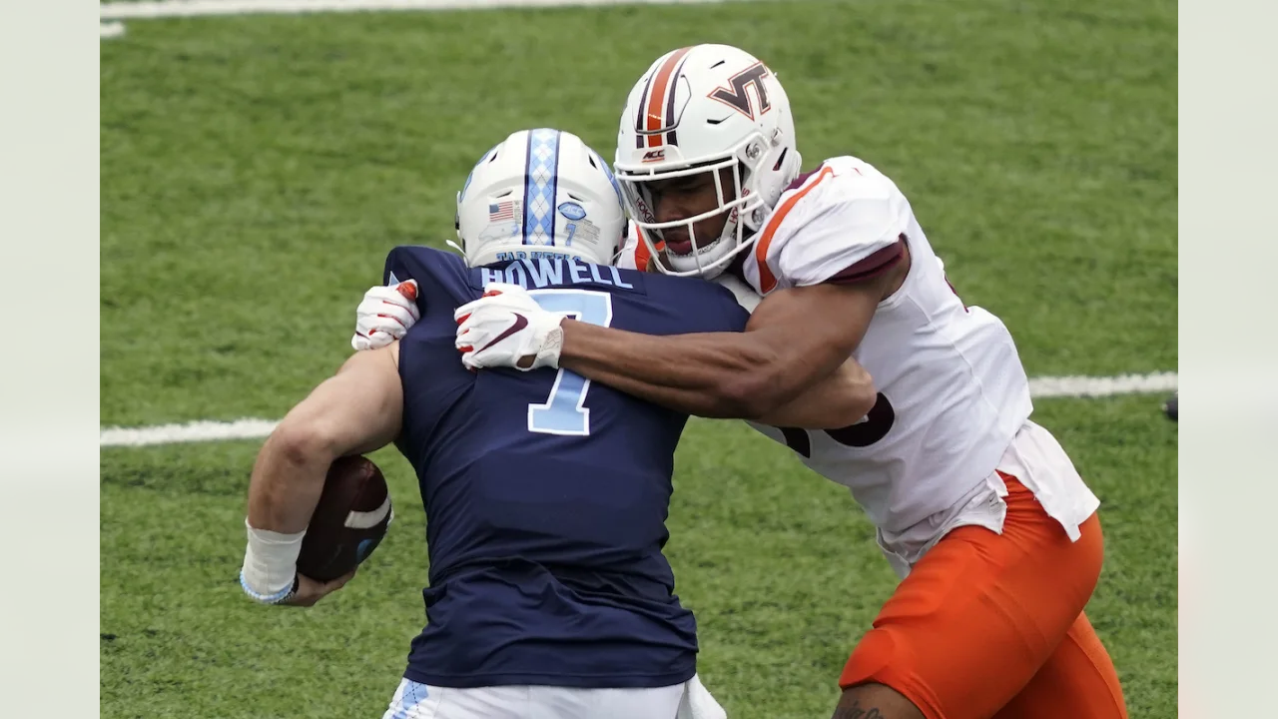
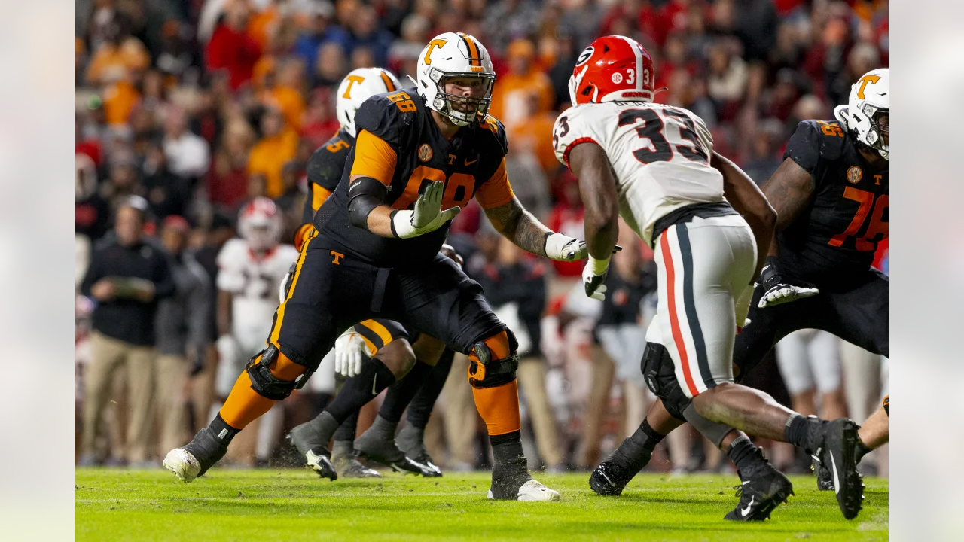
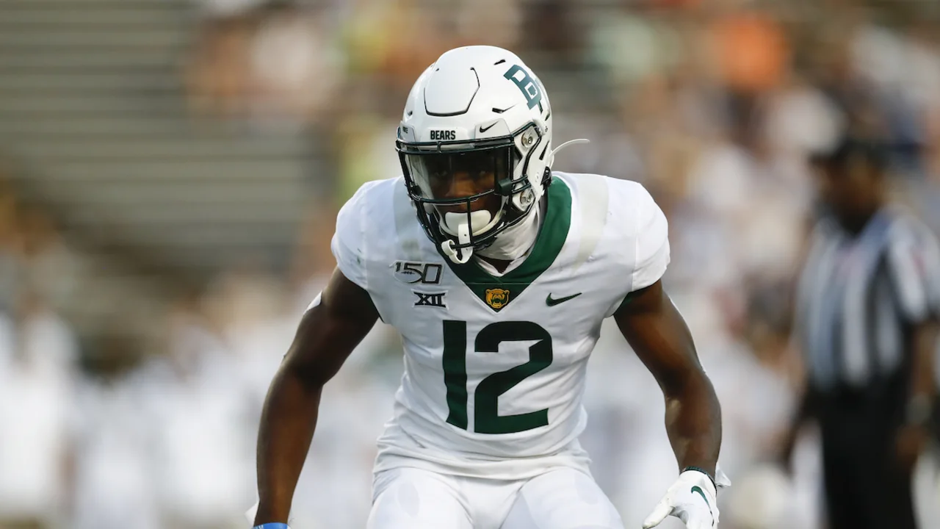
Panthers Focus
Draft Players
Offensive Tackle Ikem Ekwonu - 1st round (6th overall)
Quarterback Matt Corral - 3rd round (94th overall)
Linebacker Brandon Smith - 4th round (120th overall)
Defensive End Amaré Barno - 6th round (189th overall)
Offensive Line Cade Mays - 6th round (199th overall)
Cornerback Kalon Barnes - 7th round (242nd overall)
Notes:
Corral sustained a very minor injury at the bowl game in January of 2022 which hurt his draft stock a little, but he is still the best quarterback option in the draft.
Ikemis a violent blocker in either gap or zone and the Panthers are hopeful he will make an immediate impact in the trenches.
He is inconsistent in pass sets and will need to develop, playing into the Bucs' strengths.

Slide 6
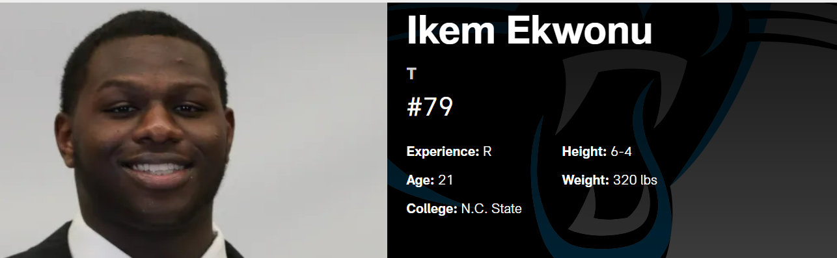
TOP DRAFT PLAYERS
With the sixth overall pick, the Panthers snagged Ickey Ekwonu
Strengths
Premier run blocker
Execution in outside zone
Violent blocker in either gap or zone
Panthers are hopeful he will make an immediate impact in the trenches.
Raw technique
Weaknesses
Inconsistent in pass sets
Rookie- Needs to develop playing into the Bucs' strengths.

Slide 7
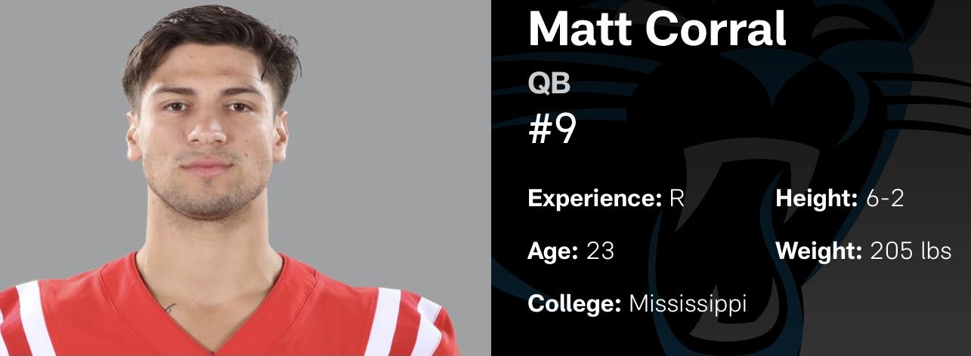
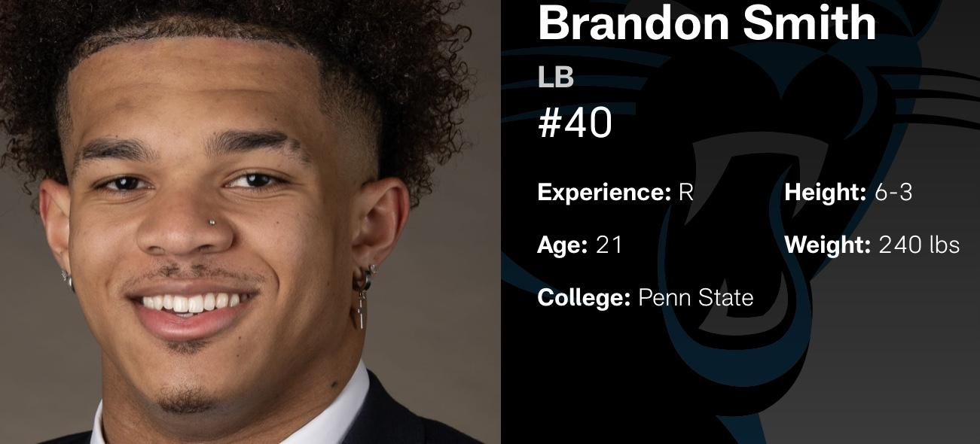
In round three the Panthers grabbed quarterback Matt Corral.
Strengths
second-best quarterback
Inexpensive
Quick release
Athleticism
High future potential
Weakness
Low accuracy on deep throws
minor injury in January
Strengths
explosive pass rush potential
athleticism to roam in coverage
Weaknesses
learn the anticipation element of the NFL
Work on miss tackles
& high tackling

Slide 8
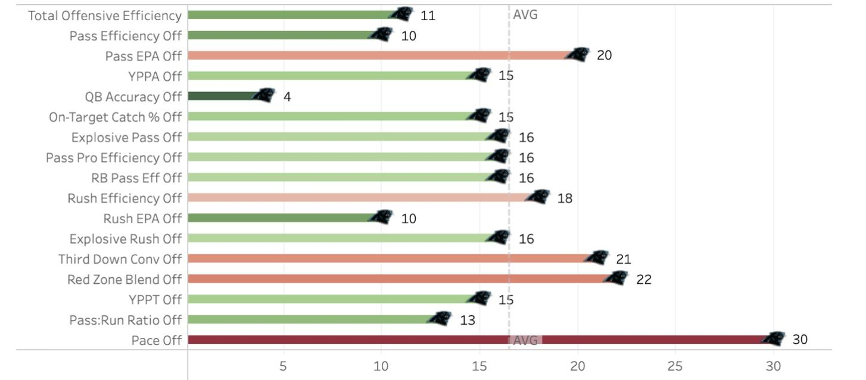
Panthers Offensive Line
Carolina panthers offensive line allowed 193 pressures, which was the most allowed in the league. Carolina's quarterbacks were pressured on 28.3% of their dropbacks, which was also a league worst.
Carolina panthers Offensive Ranking
Offensive Starters 2021
Left Tackle - Cameron Erving
Left Guard - Pat Elflein
Center - Matt Paradis
Right Guard - John Miller
Right Tackle - Taylor Moton

Slide 9
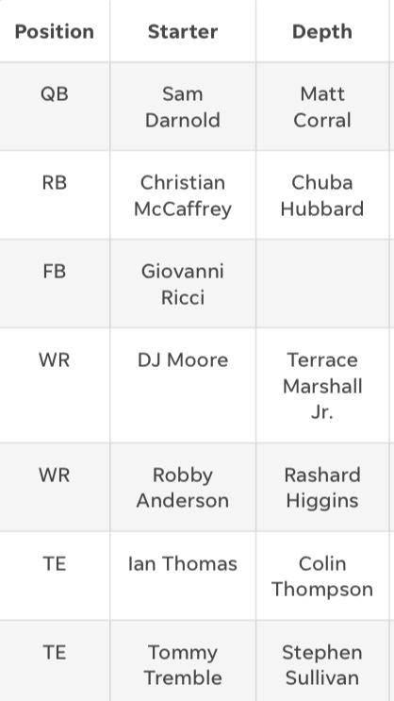
Expected offensive starters 2022
The Panthers new options could give the signal-caller vital time to go through progressions and also plow big lanes for running back Christian McCaffrey to do his thing for good measure.
Other spots that could use some additional help include tight end and the slots behind Moore and Anderson at wideout.
Christian McCaffery had high usage rate since he was drafted but Chubba is a great alternative.
Notes:
RB- christian mccaffery coming back.
LT, C, RG Changed.
(Starter plays most of the time esp for line men depth is basically a backup)
right guard Austin Corbett coming in after a stint starting for the Super Bowl-champion Rams,
that side of the line looks like the kind of thing they can build on.
the Panthers have more options than in the past, from a center competition that includes Bradley Bozeman and Pat Elflein, to drafting Ikem Ekwonu to play left tackle, and a collection of players including Brady Christensen, Michael Jordan, Deonte Brown, and Cade Mays who could all play a role.

Slide 10
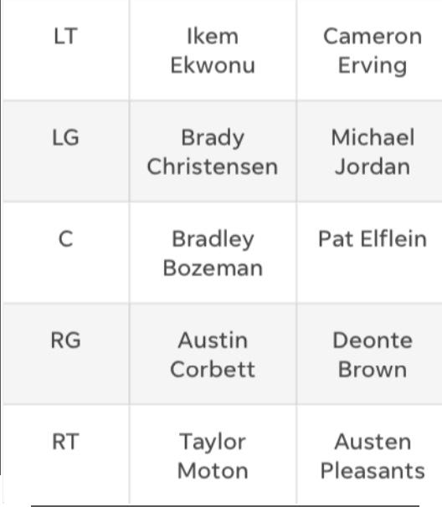
Offensive line men
.
LT, C, RG Changed.
Right guard Austin Corbett coming in after a stint starting for the Super Bowl-champion Rams, that side of the line looks like the kind of thing they can build on.
The Panthers have more options than in the past, from a center competition that includes Bradley Bozeman and Pat Elflein, to drafting Ikem Ekwonu to play left tackle.
A collection of players including Brady Christensen, Michael Jordan, Deonte Brown, and Cade Mays who could all play a role.
Notes:
Starter plays most of the time esp for line men depth is basically a backup)

Slide 11
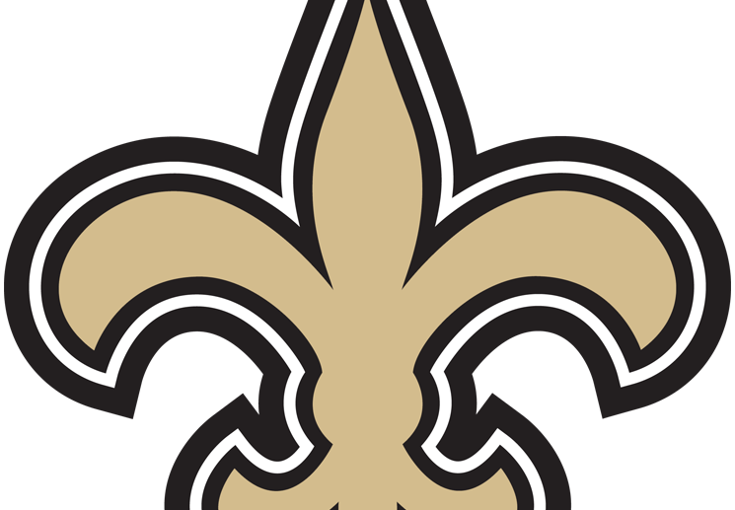
New Orleans Saints Scouting Report

Slide 12
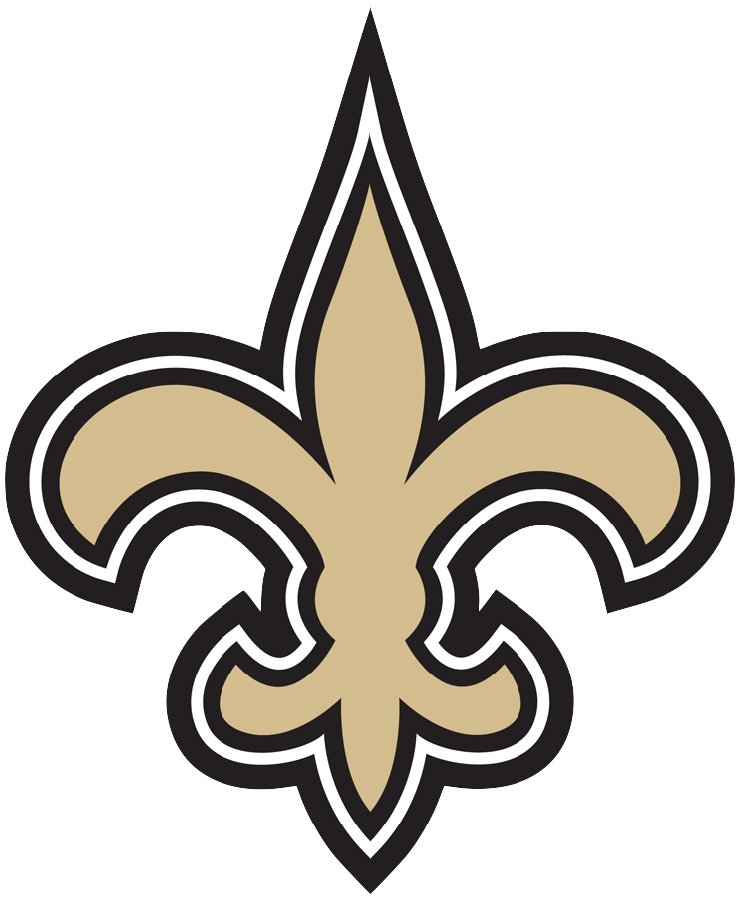
2021 Statistics
Record: 9-8
Coach: Sean Payton
Points For: 364 (21.4/g) 19th of 32
Points Against: 335 (19.7/g) 4th of 32
Expected W-L: 9.3-7.7
SRS: 2.05 (14th of 32), SOS: .34
Offensive Coordinator: Pete Carmichael
Defensive Coordinator: Dennis Allen
Coaching Changes
Coach: Dennis Allen
Defensive Coordinator: Ryan Nielson, Kris Richard
Expected W-L - this is an estimate of what the team’s record “should have been,” given the team’s points scored and allowed.
SRS - Simple Rating System uses a team’s point differential and strength of schedule to assign a rating to each team, with 0.0 considered average.

Slide 13
Additions and Departures
Free Agency
WR Jarvis Landry
S Tyrann Mathieu
S Marcus Maye
QB Andy Dalton
LB Eric Wilson
S Daniel Sorensen
DE Taco Charlton
DT Jaleel Johnson
DT Kentavius Street
Draft
WR Chris Olave
OT Trevor Penning
S Alontae Taylor
Key Departures
LT Terron Armstead
S Marcus Williams
RB Ty Montgomery
QB Trevor Siemian
TE Garrett Griffin

Slide 14
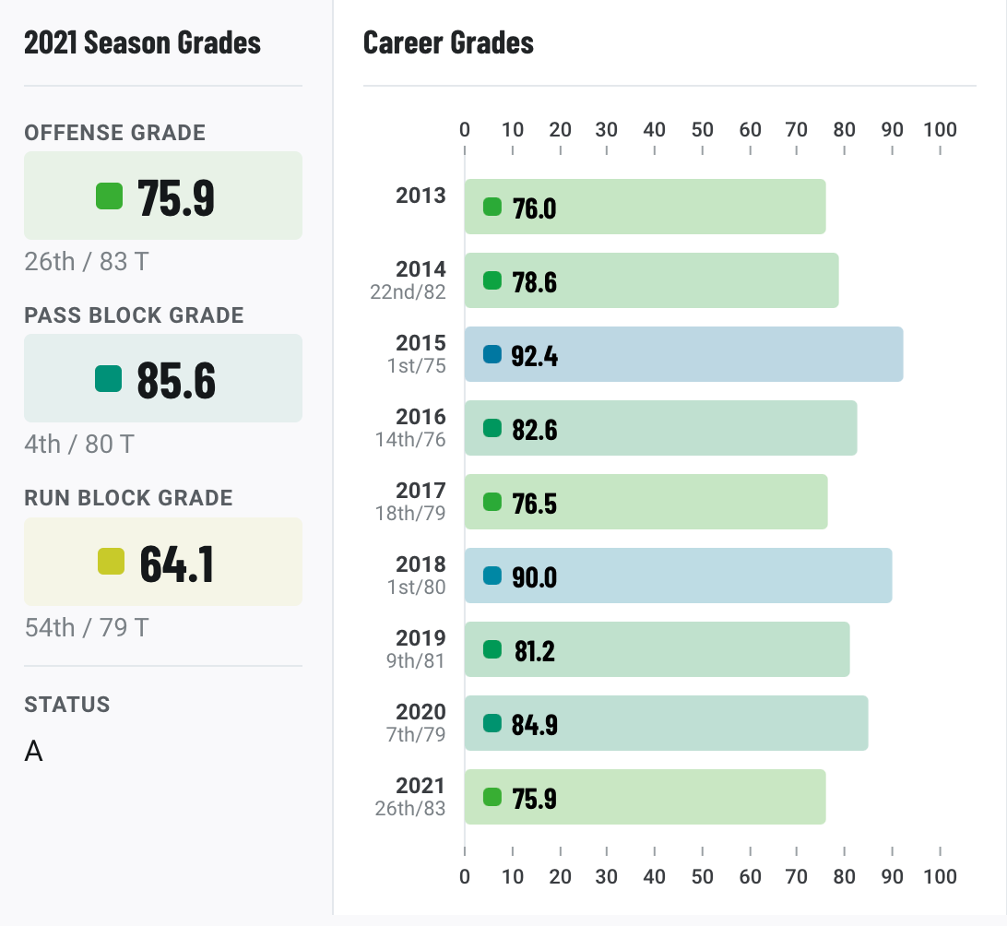
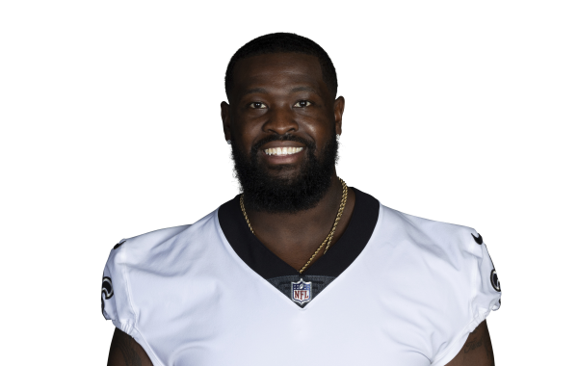
Terron Armstead - LT
Solid left tackle throughout his career
More efficient pass blocker
One of the best tackle duos in the NFL
RT Ryan Ramczyk
Trouble with injury

Slide 15
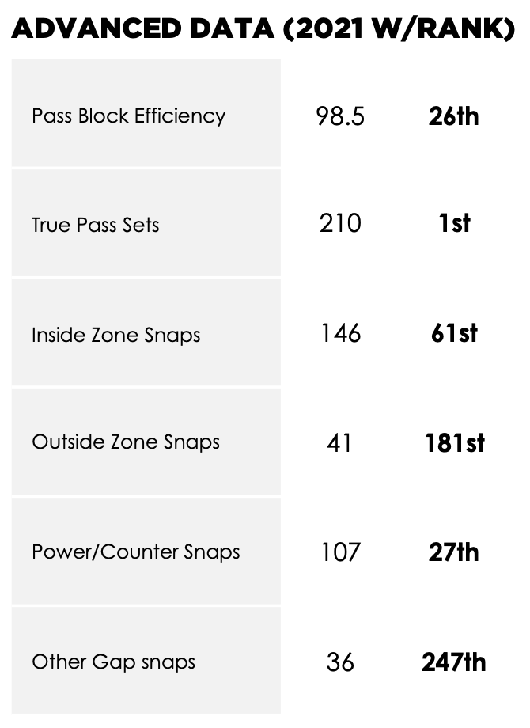
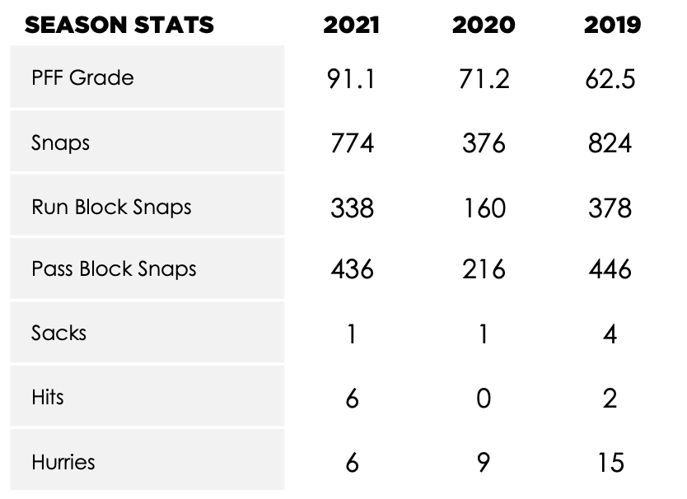
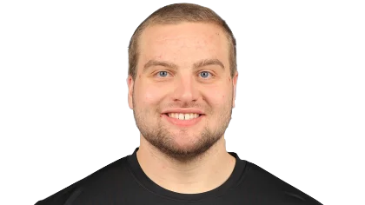
Trevor Penning - LT
1st round pick
Pros
Huge measurables
Physicality in the run game
Cons
Messy in pass protection
Low competition

Slide 16
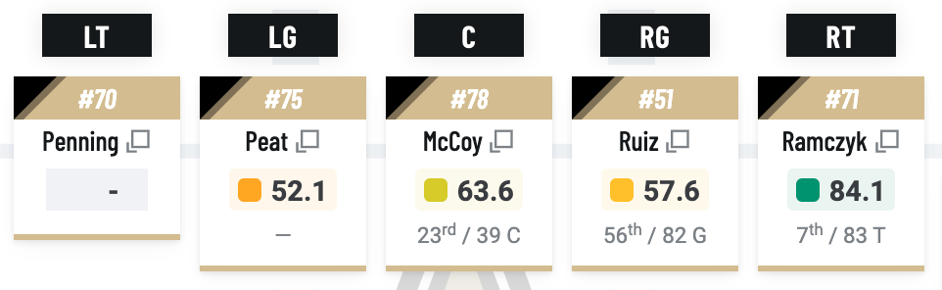
Offensive Line
LT Trevor Penning - unproven 1st round pick
Tier 2 tackle
Interior is attackable
LG Andrus Peat - 52.1
C Erik McCoy - 63.6
RG Cesar Ruiz - 57.6

Slide 17
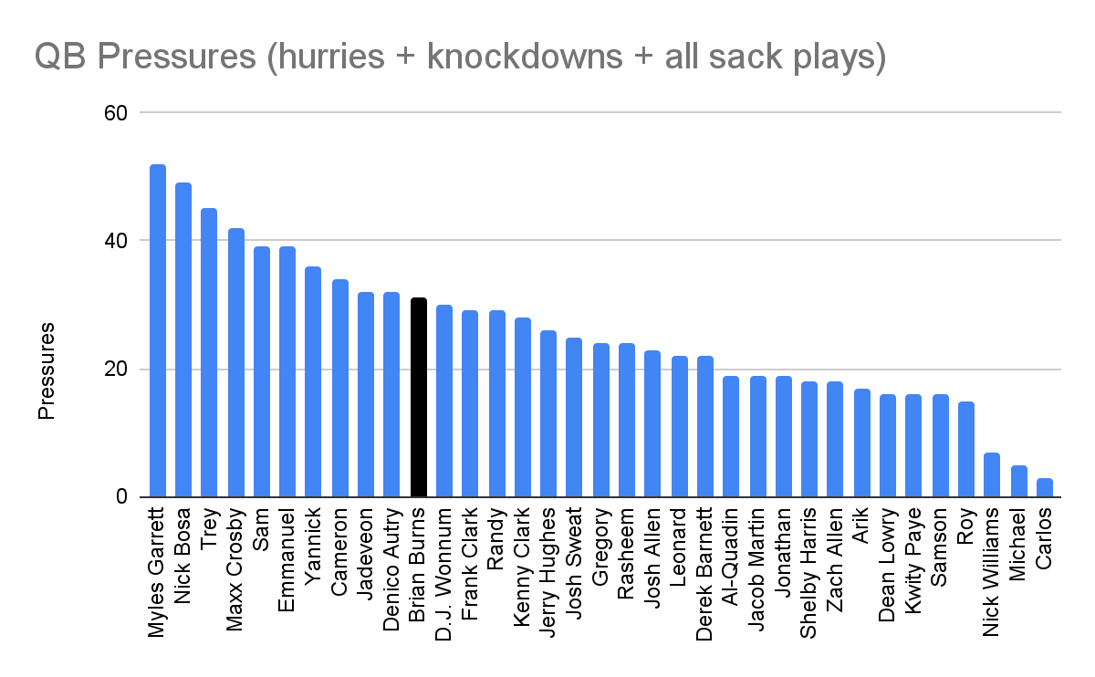
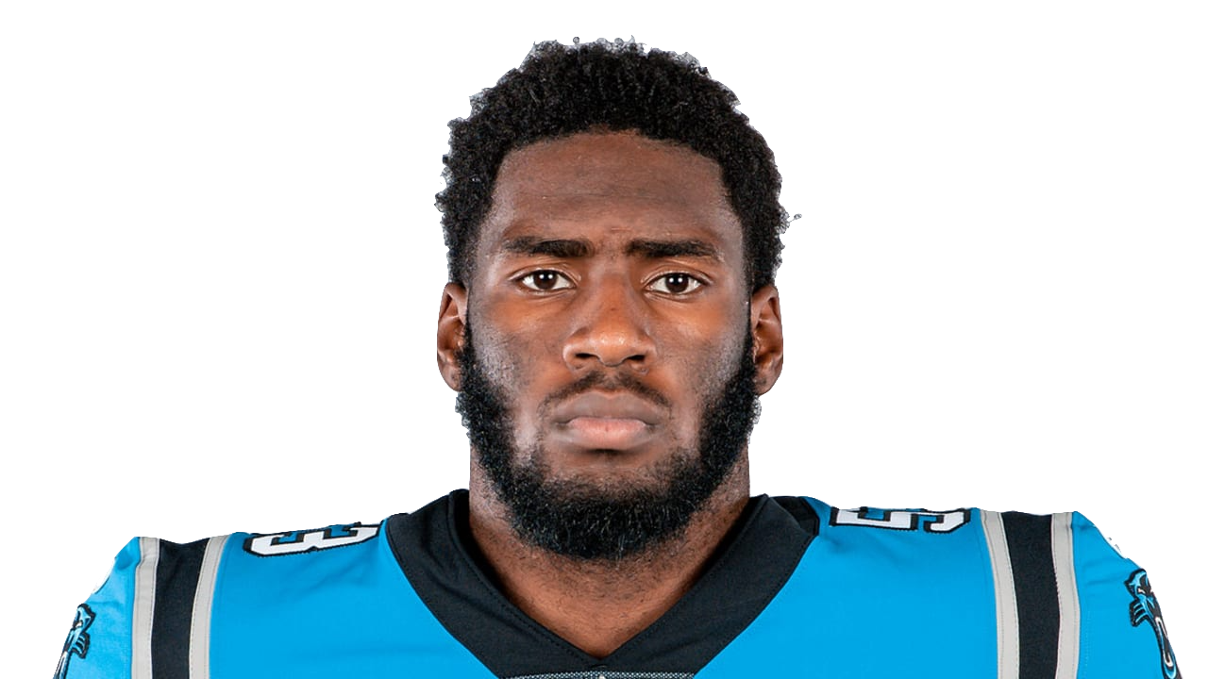
Brian Burns - DE
One of the best pure pass rushers in the league
Registered 31 pressures last season
At RDE, he can take advantage of Trevor Penning
Over 10 games started. DE only

Slide 18
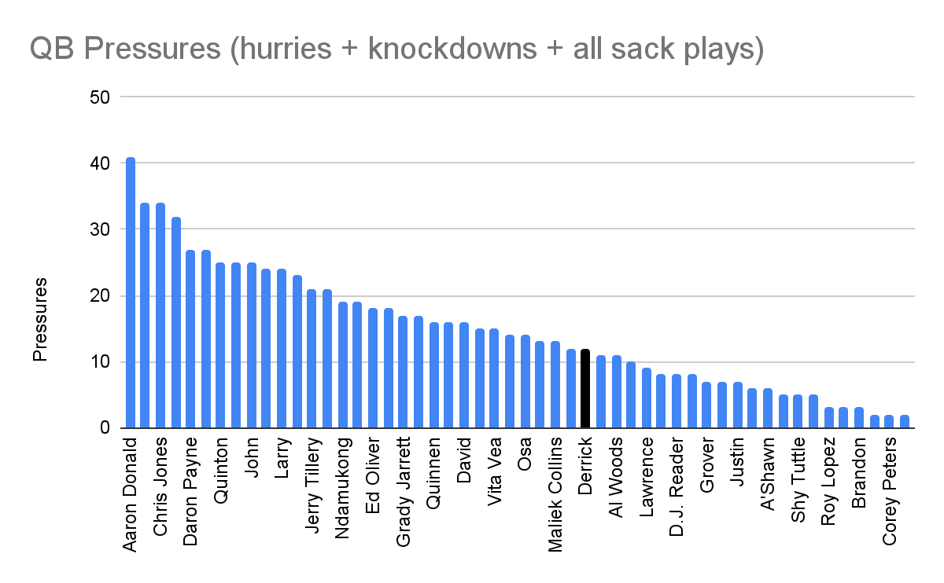
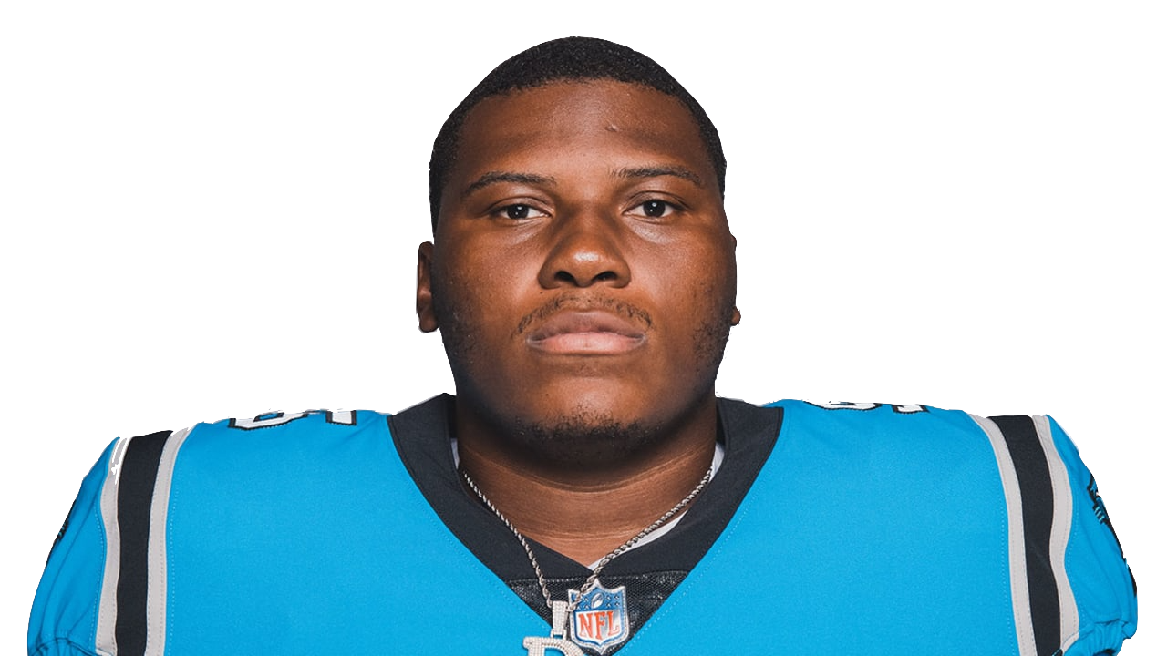
Derrick Brown - DT
Solid
Run stuffer
Can penetrate up the middle
Creates space for other on the DL
Over 10 games started. DT only

Slide 19
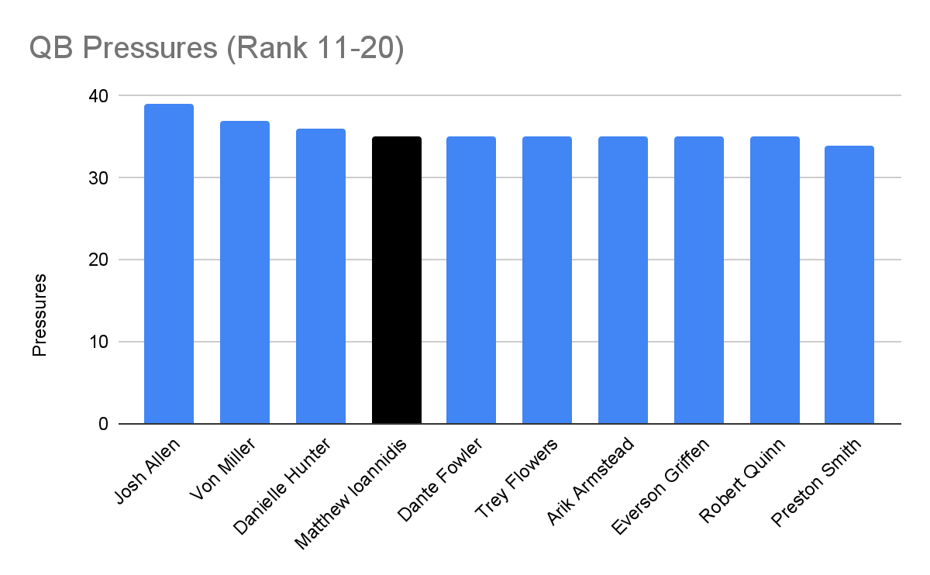
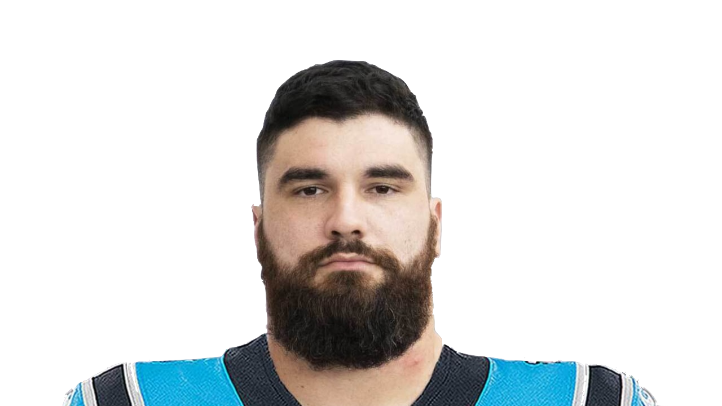
Matt Ioannidis - DT
Started 6 games last year
Recorded 12 pressures
2 per game
2019 - started 15 games
Recorded 35 pressures
All players ranked by Pressures

Slide 20
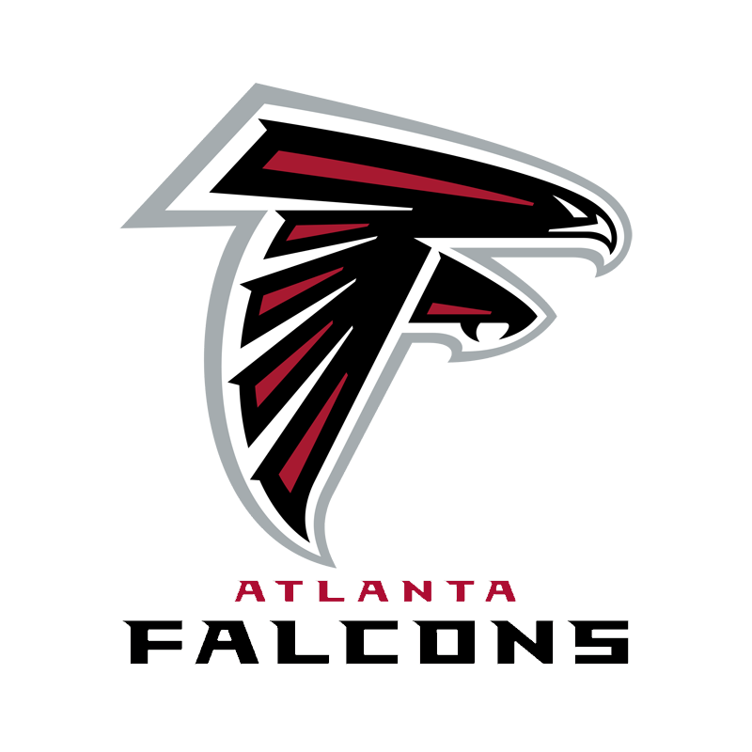
Atlanta Falcons Scouting Report

Slide 21
Falcons Information
Additions
Free Agency
CB Casey Hayward
LB Lorenzo Carter
QB Marcus Mariota
OL Germain Ifedi
WR KhaDarel Hodge
WR Damiere Byrd
TE Anthony Firkser
LB Rashaan Evans
Draft
WR Drake London
ED Arnold Ebiketie
LB Troy Andersen
QB Desmond Ridder
ED DeAngelo Malone
Departures
QB Matt Ryan
WR Russell Gage
LB Foye Oluokun
TE Hayden Hurst
TE Lee Smith
LB Dante Fowler
DT Tyeler Davison
P Thomas Morstead

Slide 22
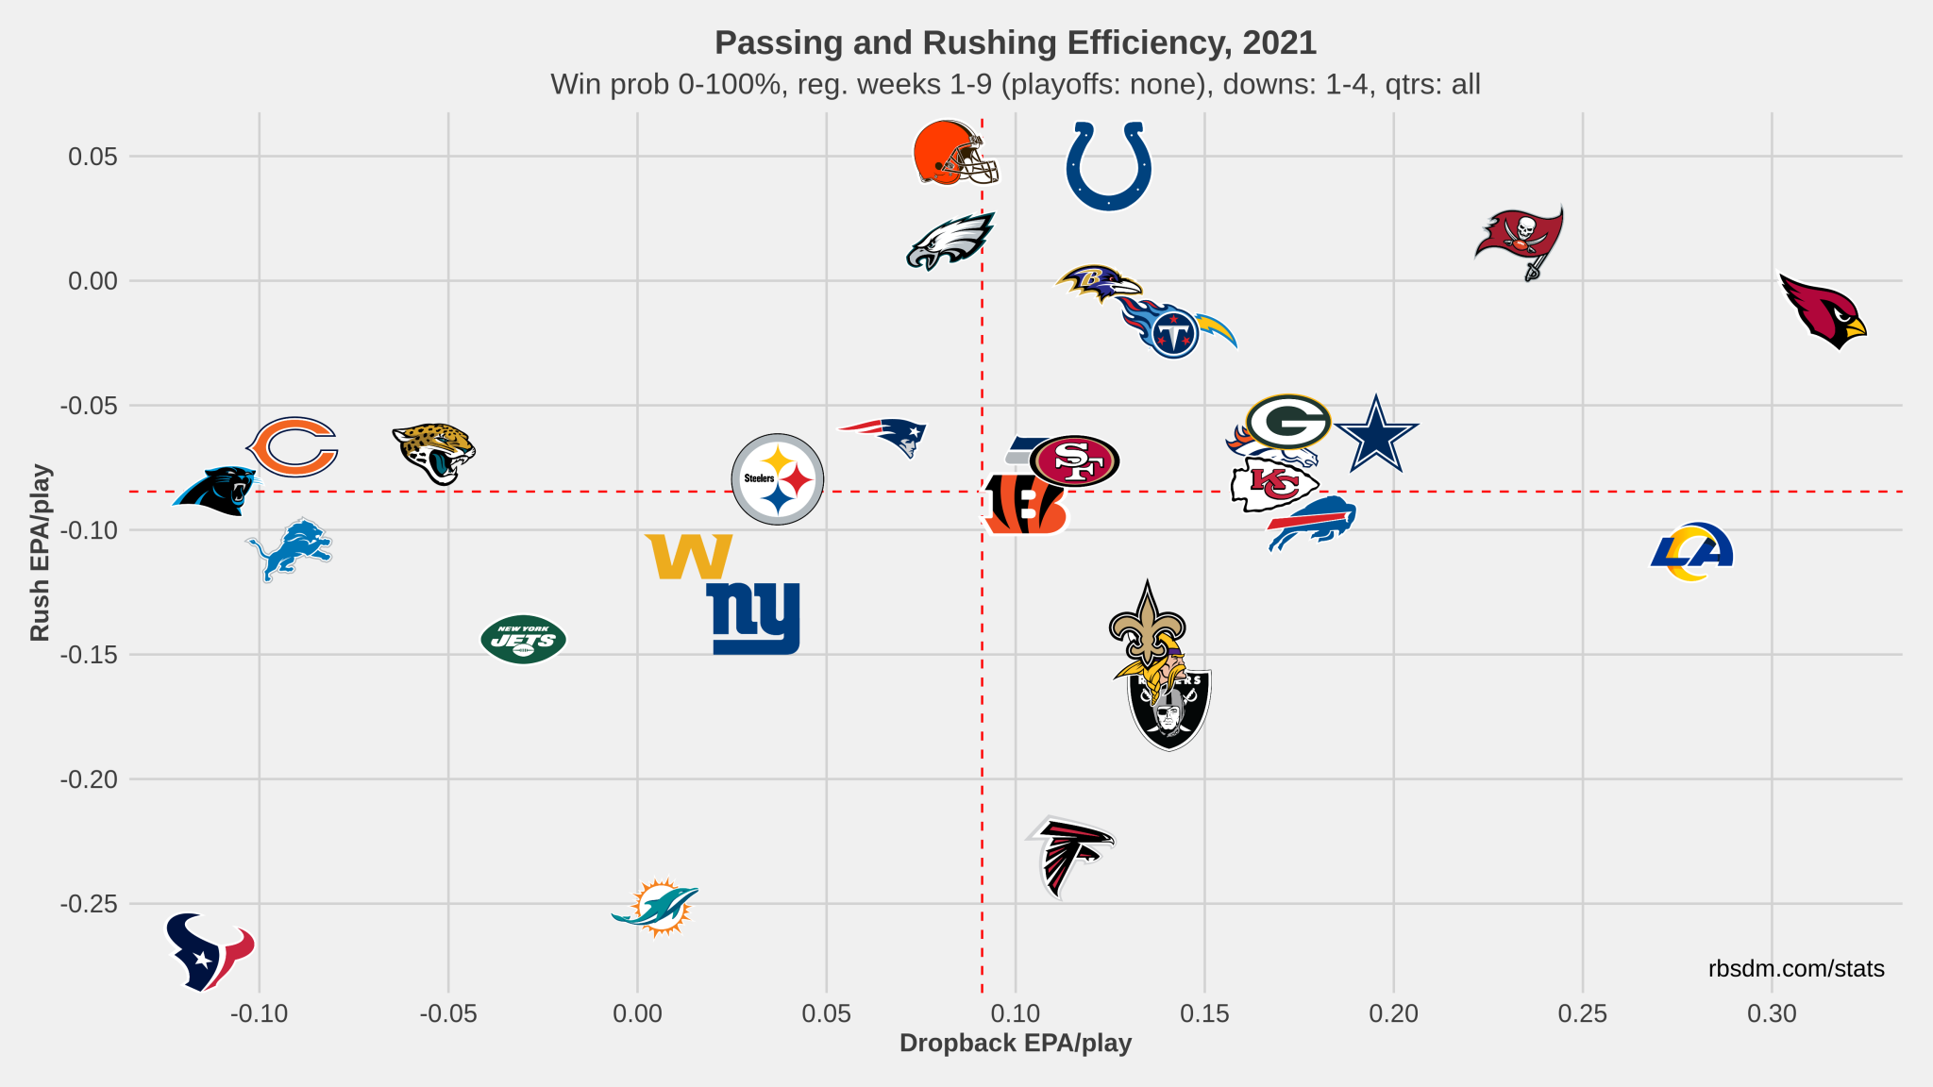

Slide 23
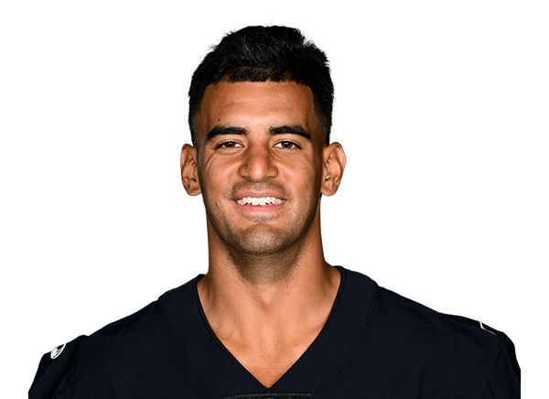
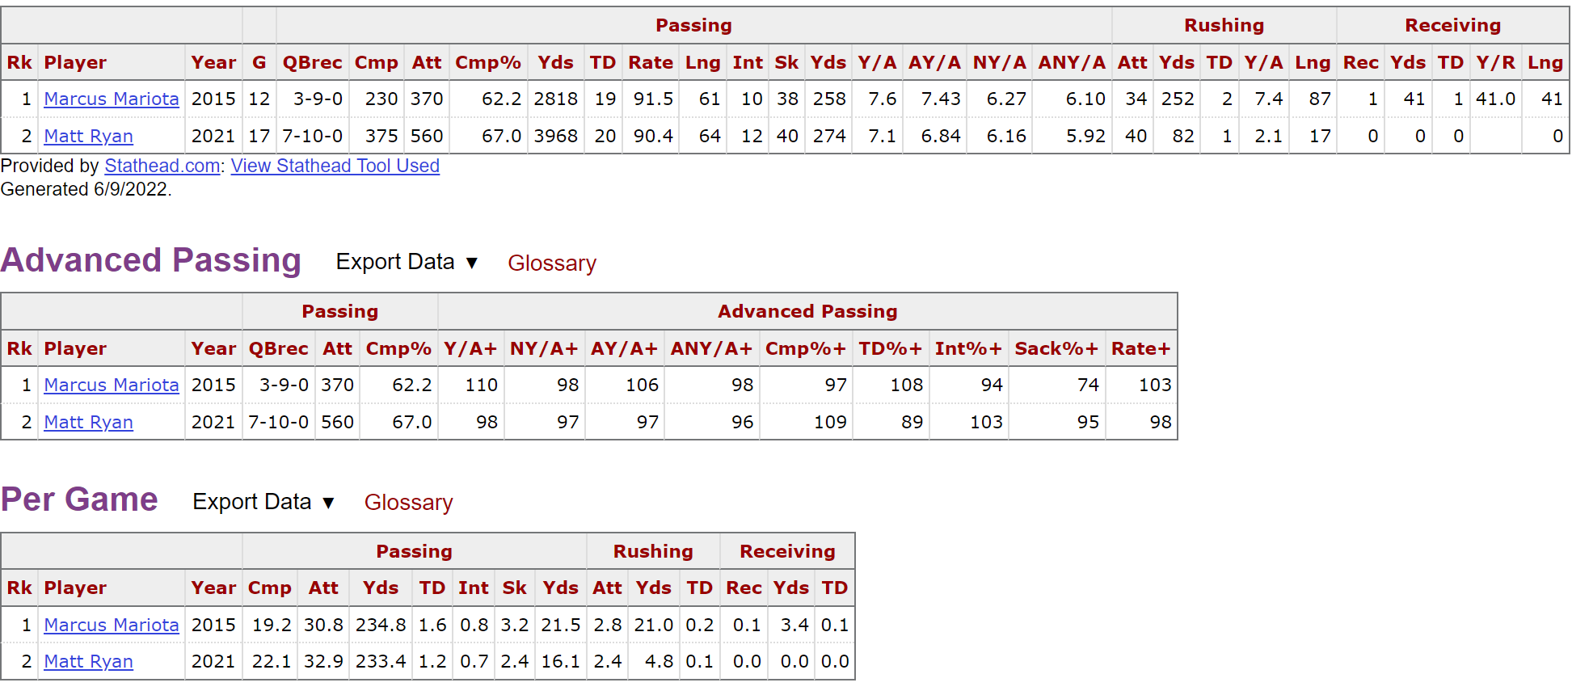
Falcons Focus
Marcus Mariota
Arthur Smith and Mariota reunite in Atlanta
First Time starting since playing with Smith in Tennessee

Slide 24
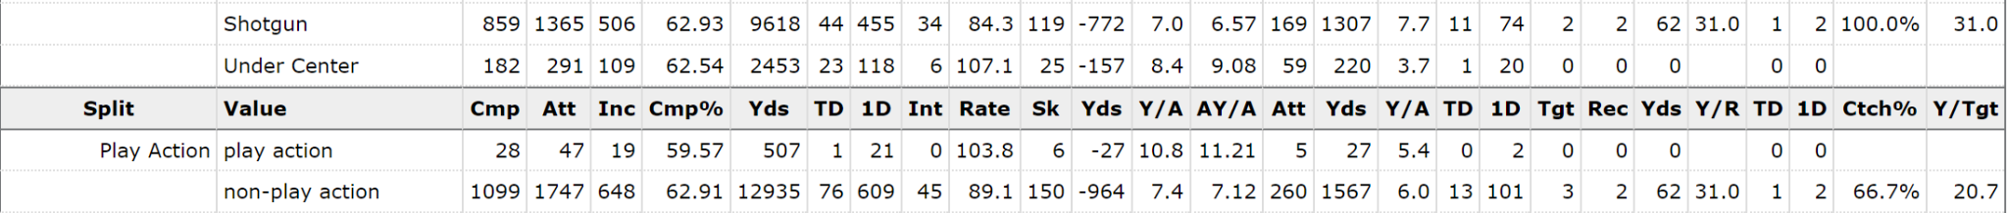
Marcus Mariota
Looking at the types of plays Smith and Mariota ran in Tennessee could tell us about the offense they are going to run in Atlanta
One of the biggest factors with Mariota is his mobility, keeping containment and forcing him to take longer in the pocket has led to more mistakes and less opportunities to use his legs

Slide 25
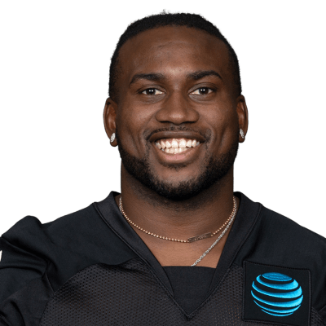
Falcons Focus
Cordarrelle Patterson
Had one of if not the best season of his career after becoming more of the running back position
Carrying the ball more times than ever, this opened up new opportunities for him in the passing game
The ability to get the ball out of Mariota’s hands quickly will be a priority and Patterson will only help him do so
Potential Increase in RPO style plays

Slide 26
Cordarrelle Patterson
Breaking Down the versatility of Cordarrelle Patterson
Rushing
63% of Pattersons rushes came on 1st and 10, 92% came on 1st or 2nd down
88% of his rushes and rushing yards came when the QB was under center, as well as all of his rushing touchdowns
21.9 Attempts per broken tackle, if you can get to him quickly he isn’t hard to take down in open field
Receiving
3.1 Yards before reception, indicate quick passes out of the backfield (quick outs, crosses, screens)
71% of his receptions came in the shotgun formation as well as all of his receiving touchdowns
71% of his receptions were on non play action plays, straight drop backs

Slide 27
Atlanta Falcons Focus
Offensive Line Problems:
Last season the Atlanta Falcons offensive line was not very good, other than Lindstrom, and have so far this offseason made only one move to help the team in this area (Germain Ifedi)
LT: Jake Matthews - 71.4
LG: Jalen Mayfield - 49.3
C Matt Hennessy - 77.0
RG: Chris Lindstrom - 84.1
RT: Kaleb McGary - 62.4
Top 5 in QB pressures and 1st in QB hits, the falcons never allowed Matt Ryan to get comfortable in the offense
Rookie Left Guard Jalen Mayfield allowed 11 sacks, was called for 9 penalties (T-8th), and had a 27.6 pff grade for pass blocking
Left tackle Jake Matthews run blocking pff grade is a 58.7, showing the left side of the line for the falcons is vulnerable
Brian Burns, Derrick Brown, Gross Mantos, and others will be counted on to aggressively attack this left side and contain Mariota

Slide 28
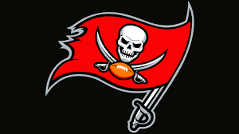
Tampa Bay Buccaneers
Scouting
Report

Slide 29
Buccaneers Information
Additions
Free Agency
DT Akiem Hicks
S Logan Ryan
RG Shaquille Mason
S Keanu Neal
WR Russell Gage
Draft
DL Logan Hall
G Luke Goedeke
RB Rachaad White
P Jake Camarda
Coaching
HC Todd Bowles
DC Kacy Rodgers/Larry Foote
Departures
TE O.J. Howard
RB Ronald Jones II
RG Alex Cappa
S Jordan Whitehead
LG Ali Marpet
DT Ndamukong Suh

Slide 30
Buccaneers Focus
How Carolina fares against them?
Based on 2021-22 Season:
A key factor to look at between the teams is the struggle at the QB position for the panthers. Throughout the season here are the the quarterbacks that started for Carolina:
Sam Darnold(11)
Cam Newton(5)
P.J. Walker(1)
Tampa Bay:
Tom Brady(17)
Based off of this it can be concluded that the buccaneers have had more effective production in the QB position, and because of this, has provided more success offensively compared to the panthers
Panthers total offensive yards: 5081 | total offensive yards given up: 5201
Buccaneers total offensive yards 6901 | total offensive yards given up: 5635
Carolina panthers ranked 2nd in the league total defense(305.9 YDS/G)
Tampa Bay Buccaneers ranked 13th in the league in total defense (331.5 YDS/G)
With that being said, some key things to take away from this is that the panthers had the 2nd best defense in the league and still managed to give up more yards defensively than the offense obtained, so it says alot about their offense. The offensive side is where the buccaneers will have the edge over the panthers in a head to head matchup.
The Buccaneers are clearly the best team in the division finishing with a 13-4 record last season
Todd Bowles, the previous defensive coordinator has been promoted to the head coaching position taking over for Bruce Arians, So there shouldn't be too much of a change in coaching schemes

Slide 31
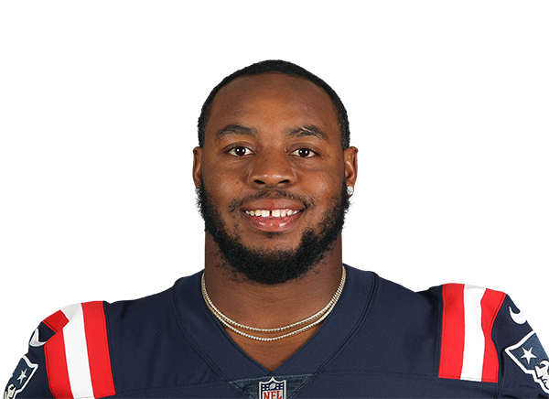
Buccaneers Guards
After the 2021-22 season, the buccaneers lost two of their starting guards.
Ali Marpet(Retired)
Alex Cappa(Signed a 4-Year, $40 Million Deal with the Bengals)
However, Tampa Bay traded for RG Shaq Mason who they plan to have starting at that position to fill that open position. Tampa Bay still hopes to fill the other slot position, according to offensive line coach Joe Gilbert.
Shaq Mason

Slide 32
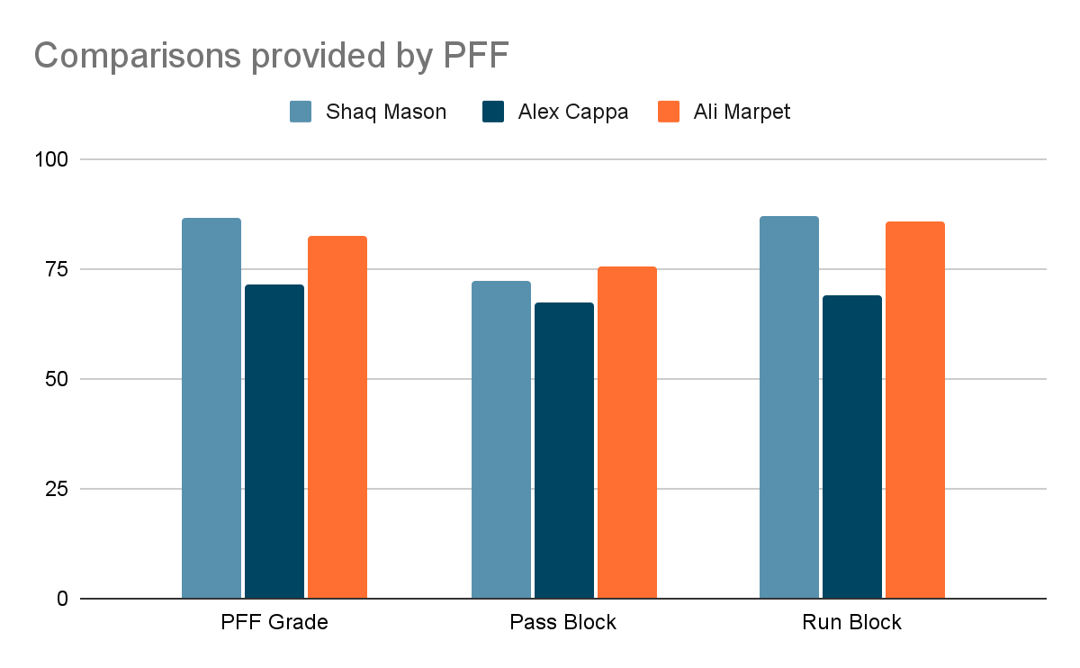
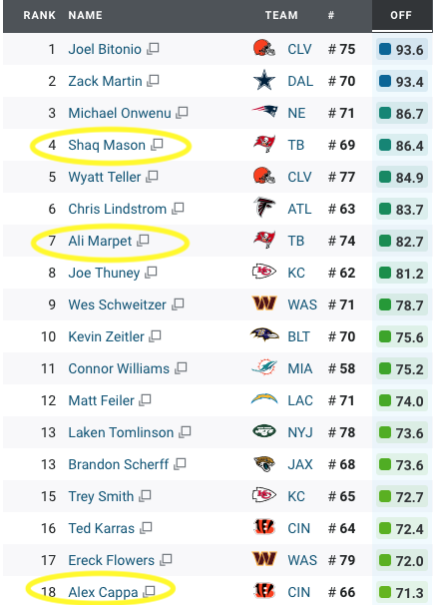
Comparing RG Shaq Mason to the departures
Shaq Mason was ranked 4th in the league last year in PFF rankings for guards.
PFF provided grades based on the guards performance throughout the season. The most notable for guards were their pass and run block. Shaq Mason had the edge in the overall PFF grade compared to the departures Alex Cappa and Ali Marpet.

Slide 33
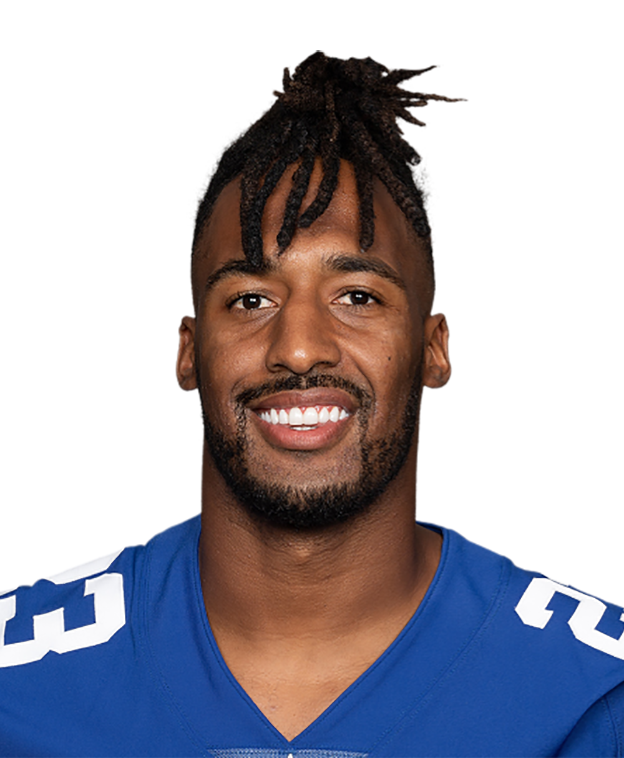
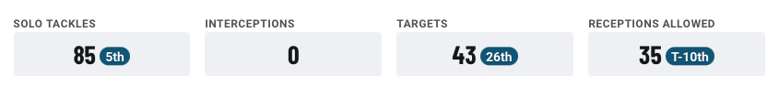
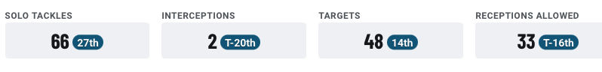
S Logan Ryan
The Buccaneers signed safety Logan Ryan to replace Jordan Whitehead, their previous starting safety that was just lost in free agency to the New York Jets
Jordan Whitehead in comparison:

Slide 34
References
The Most Powerful Research Tools in Sports | Stathead.com
www.panthers.com
https://www.si.com/nfl/panthers/gm-report/projecting
https://www.pro-football-reference.com/
https://www.pff.com/

